Slide 1



GRT INSTITUTE OF
ENGINEERING AND
TECHNOLOGY, TIRUTTANI - 631209
Approved by AICTE, New Delhi Affiliated to Anna University, Chennai
DEPARTMENT OF ELECTRONICS AND COMMUNICATION ENGINEERING
Accredited by NBA, New Delhi
SMART CITIES MANHOLE COVER MANAGEMENT SYSTEM BASED ON IOT EDGE COMPUTING
REVIEW – II (13/04/2023)
Batch No. - XI
Present By:-
1. HEMANTH R - 110319106013
2. KARTHIK A K - 110319106016
3. NITHISH KUMAR V R - 110319106031
Guided By.
Dr.P.SIVAKUMAR,ME.P.hd.,
Professor
Department of Electronics and Communication Engineering

Slide 2
TABLE OF CONTENT :
OBJECTIVE
ABSTRACT
LITRACTURE SURVEY
LITRACTURE SURVEY
LITRACTURE SURVEY
LITRACTURE SURVEY
PROBLEM IDENTIFICATION & FORMULATION
PROPOSED WORK
BLOCK DIAGRAM
REQUIREMENGTS
BLOCK DIAGRAM EXPLANATION
GRTIET, Department of Electronics and Communication Engineering

Slide 3
OBJECTIVES
In an edge computing-based manhole cover management system enables real-time monitoring of the status of manhole covers. The IoT sensors can detect changes in the status of the manhole covers, such as if a cover is open or closed, and send this information to the edge computing system.
This early detection can prevent accidents and reduce the risk of injury to citizens, making cities safer.
By analyzing the data collected from sensors and GSM, the system can predict potential failures in manhole covers and generate alerts for preventive maintenance
GRTIET, Department of Electronics and Communication Engineering

Slide 4
ABSTRACT
A smart city is the future goal to have cleaner and better for the society. Smart underground infrastructure is an important feature to be considered while implementing a smart city. Drainage system monitoring plays a vital role in keeping the city clean and healthy. Since manual monitoring is incompetent, this leads to slow handling of problems in drainage and consumes more time to solve. To mitigate all these issues, the system using a wireless sensor network, consisting of sensor nodes is designed. The system also provides a real-time alert to the relevant authorities, enabling them to take immediate action The proposed system is low cost, low maintenance Internet of Things (IoT) devices, and artificial intelligence algorithms based real time which alerts the managing station through an email / message when any manhole crosses its threshold values and to check whether a manhole cap is open or closed . This system reduces the death risk of manual scavengers who clean the underground drainage and also benefits the public.
Keywords: Arduino, edge-computing, Manhole management, Smart cities, IOT.
GRTIET, Department of Electronics and Communication Engineering

Slide 5
LITERATURE SURVEY
REVIEW PAPER 1:
MANHOLE COVER INTELLIGENT DETECTION AND MANAGEMENT SYSTEM
Author : Xinru Fu
Journal :Atlantis Press
Year of Published : 2016
DISCRIPTION: In order to avoid the risks that imperfect manhole cover and feature to bring, this paper, aiming at the existing problem of manhole cover, proposed a detectable and maintainable regionalization covers intelligent security management system. Many sensors set up in the manhole cover to real-time monitor its situation, Through MCU、RF Wireless Data Communication Module and upper computer to understand and control manhole cover, this system could monitor the city manhole cover in real time and give an alarm automatically.
DRAWBACK : Can’t able to sent message.
GRTIET, Department of Electronics and Communication Engineering

Slide 6
LITERATURE SURVEY
REVIEW PAPER 2:
SECURE MANHOLE MONITORING SYSTEM EMPLOYING SENSORS AND GSM TECHNIQUES
Author : Nataraja N, Amruthavarshini R, Chaitra N L , Jyothi K , Krupaa N, S S M Saqquaf
Journal :IEEE Xplore
Year of Published: 2018
DISCRIPTION: This Paper Opening for manholes due to breakage of manhole cover, manhole explosions are major threat in recent days. Manhole cover opening leads to accidental fall of vehicles, pedestrians leading to accidents or loss of life. Manhole opening detection and alerting is mainly based on detecting the manholes which are opened due to overflow of sewage / rain water during heavy rainfall and alerting. When a manhole opening is detected either due to overflow of sewage water, increase in pressure or temperature, it leads to the breakage of the manhole lids. To avoid such incidents even before it could affect the public, an alerting system is built wherein the buzzer alerts the surrounding and sends the sensed data to the managing authorities using GSM techniques. So, they can take precautionary action to close the manhole considering public safety.
DRAWBACK : Main disadvantage is unable to store maintenance database .
In this Project can’t able to track the perticular
GRTIET, Department of Electronics and Communication Engineering

Slide 7
LITERATURE SURVEY
REVIEW PAPER 3:
IOT BASED AUTOMATED MANHOLE DETECTION
Author : Dr.T.Menakadevi , Akash.M , Dilip kumar.B , Kannan.M , Chandra Mohan.S
Journal :International Research Journal of Engineering and Technology (IRJET)
Year of Published : 2021
DISCRIPTION: - Smart underground infrastructure is an important feature to be considered while implementing a smart city. Drainage system monitoring plays a vital role in keeping the city clean and healthy. Since manual monitoring is incompetent, this leads to slow handling of problems in drainage and consumes more time to solve. To mitigate all these issues, the system using a wireless sensor network, consisting of sensor nodes is designed. The proposed system is low cost, low maintenance IoT based real time which alerts the managing station through an email when any manhole crosses its threshold values.
DRAWBACKS : Unable to store maintenance database and manhole Cover can’t close automatically
Need internet access.
GRTIET, Department of Electronics and Communication Engineering

Slide 8
PROBLEM IDENTIFICATION AND FORMULATION
PROBLEM IDENTIFICATION :
Need Internet access.
All of the maintains data won't be stored in the current system.
There is no flow sensor to detect the flow of water.
The flow of manhole waters cannot be detected in any previous papers.
FORMULATION :
No need of Internet access.
Edge computing can store the manhole maintenance data.
Flow of water can be detected
Blockage of water also detected by flow sensor.
GRTIET, Department of Electronics and Communication Engineering

Slide 9
PROPOSED WORK
In the proposed method, development of IoT based drainage and manhole monitoring system is designed. This system monitors temperature, manhole lid position whether it will opened or close. Maximum levels are set and sensors keep monitoring the changing conditions. As the levels reach a maximum set point the sensors detect and send the signal to controller, where it commands the IoT network to generate alerts to the “Municipal Corporation”. Gas sensor will monitor the toxic gases, Flow sensor will detect the Flow rate of the manhole water, hence the water flow blockage also easily detected. DHT11 sensor will monitor the Temperature and humidity. If any of the sensor data increases greater than threshold value then GSM (Global System for Mobile communication) will send the message to Municipal Corporation and buzzer will give alerts.
In This proposed solution user doesn’t need to have internet access in his device to get update from this manhole Monitoring & detection system
GRTIET, Department of Electronics and Communication Engineering

Slide 10
BLOCK DIAGRAM
Power Supply
Cloud Server
Gas Sensor
Arduino
IR Sensor
GSM/GPRS
Ultrasonic
Sensor
Mobile
Flow Sensor
DHT11
LCD
GRTIET, Department of Electronics and Communication Engineering

Slide 11


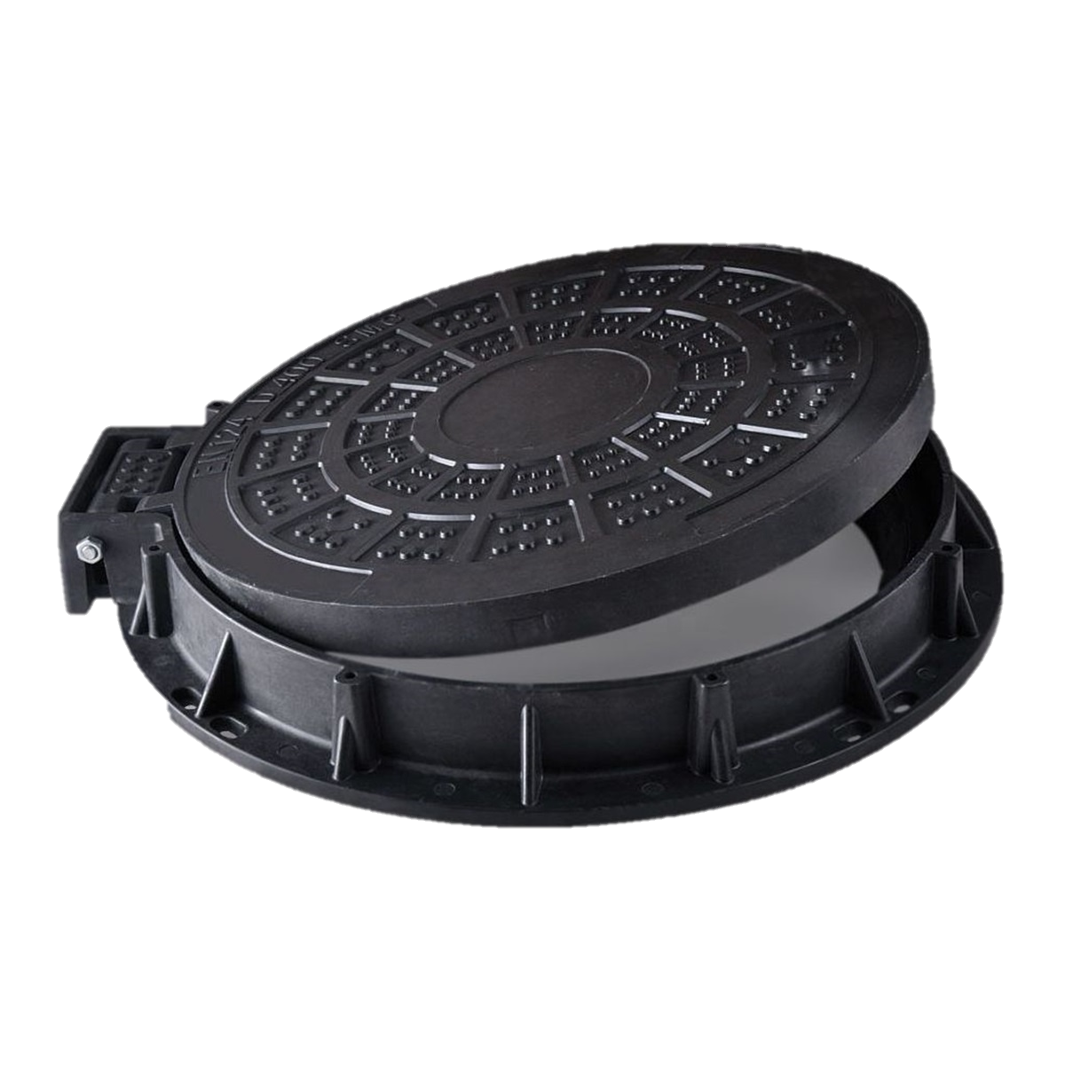
Cloud Server
Municipal Corporation
Municipal Corporation
MANHOLE COVER MANAGEMENT SYSTEM
GRTIET, Department of Electronics and Communication Engineering

Slide 12
REQUIREMENTS
HARDWARE REQUIREMENTS | SOFTWARE REQUIREMANTS
Arduino | Arduino IDE
Gas sensor (MQ2) | Programed by C
IR sensor
Ultrasonic Sensor
Flow Sensor
GSM/GPRS module
LCD
DTH11 Sensor
Buzzer
GRTIET, Department of Electronics and Communication Engineering

Slide 13
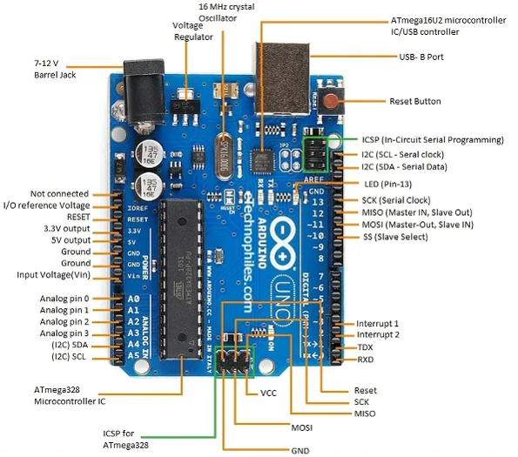
ARDUINO
Arduino is an open-source electronics platform based on easy-to-use hardware and software.
It has 14 digital input/output pins
(of which 6 can be used as PWM outputs), 6 analog inputs
MODEL : ARDUINO UNO 3
GRTIET, Department of Electronics and Communication Engineering

Slide 14
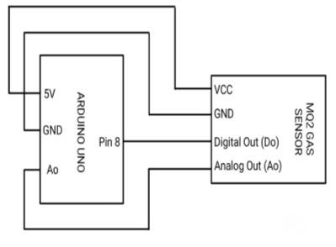
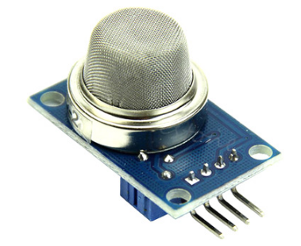
GAS SENSOR
The MQ-2 is a smoke and combustible gas sensor from Winsen. It can detect flammable gas in a range of 300 - 10000ppm
Connecting pins
GRTIET, Department of Electronics and Communication Engineering

Slide 15
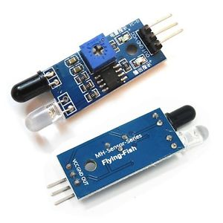
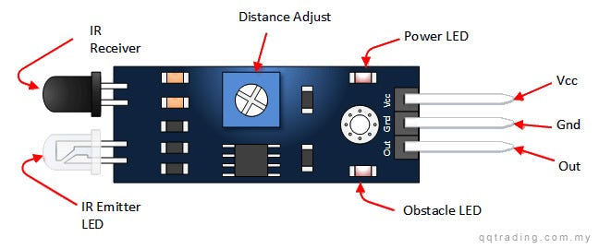
IR SENSOR
An infrared sensor is an electronic device, which emits in order to sense some aspects of the surroundings. An IR sensor can measure the heat of an object as well as detects the motion.
#define IR_SENSOR_PIN 5
VCC -> 5V
GND -> GND
OUT -> pin 1
GRTIET, Department of Electronics and Communication Engineering

Slide 16
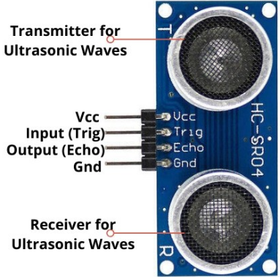
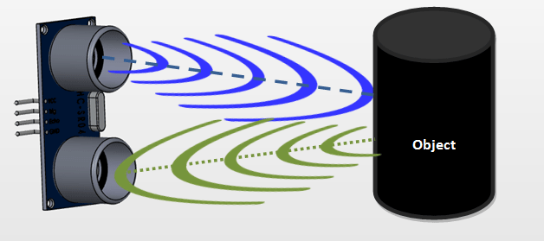
ULTRASONIC SENSOR
An ultrasonic sensor is an electronic device that measures the distance of a target object by emitting ultrasonic sound waves, and converts the reflected sound into an electrical signal. Ultrasonic waves travel faster than the speed of audible sound (i.e. the sound that humans can hear
#define ULTRASONIC_TRIG_PIN 6
#define ULTRASONIC_ECHO_PIN 7
Distance = Speed × Time
GRTIET, Department of Electronics and Communication Engineering

Slide 17
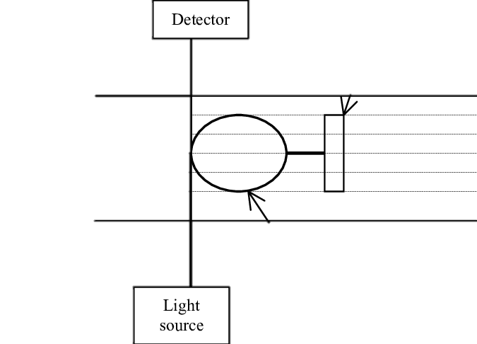
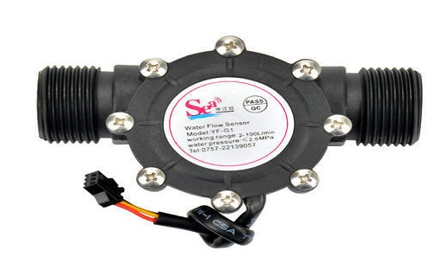
FLOW SENSOR
A flow sensor is a component that measures the flow of a fluid such as a gas or liquid. Flow sensors utilize both mechanical and electrical subsystems to measure changes in the fluid's physical attributes and calculate its flow.
#define FLOW_SENSOR_PIN 2
GRTIET, Department of Electronics and Communication Engineering

Slide 18
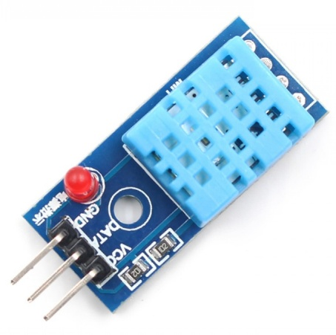
DHT11
The DHT11 is a basic, low-cost digital temperature and humidity sensor. It uses a capacitive humidity sensor and a thermistor to measure the surrounding air, and spits out a digital signal on the data pin (no analog input pins needed). It’s fairly simple to use, but requires careful timing to grab data. The only real downside of this sensor is you can only get new data from it once every 2 seconds.
#define DTH11_PIN 4
GRTIET, Department of Electronics and Communication Engineering

Slide 19
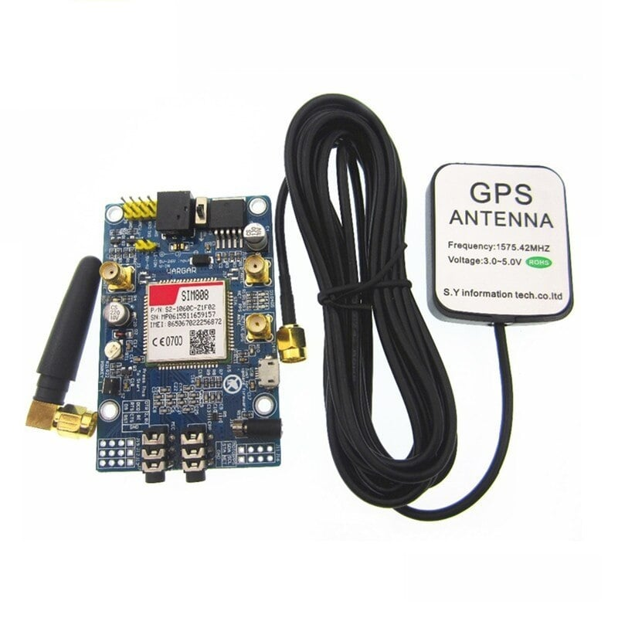
GSM/GPRS
A GSM GPRS module is utilized to speak with the GSM/GPSR arrange by a microcontroller (or coordinated circuits). GSM is the Global Mobile Communication System and GPRS would be the General Packet Radio Service. A GSM GPRS MODEM consolidates a GSM GPRS module similarly as various fragments, for instance, correspondence interface, (for instance, Serial Communication-RS-232), control supply and a couple of pointers.
GSM – used to send the information to municipality
GPRS- used to track the location
#define GSM_RX_PIN 9
#define GSM_TX_PIN 10
GRTIET, Department of Electronics and Communication Engineering

Slide 20
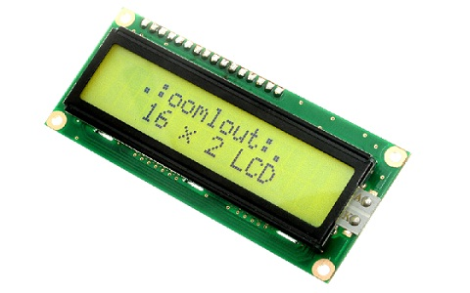
LCD
The liquid crystal display (LCD) panel is designed to project on-screen information of a microcomputer onto a larger screen with the aid of a standard overhead projector
#define LED_PIN 3
GRTIET, Department of Electronics and Communication Engineering

Slide 21
ARDUINO IDE TOOL – CODING
#include <Wire.h>
#include <SoftwareSerial.h>
// Define pin numbers for components
#define FLOW_SENSOR_PIN 2
#define LED_PIN 3
#define DTH11_PIN 4
#define IR_SENSOR_PIN 5
#define ULTRASONIC_TRIG_PIN 6
#define ULTRASONIC_ECHO_PIN 7
#define BUZZER_PIN 8
#define GSM_RX_PIN 9
#define GSM_TX_PIN 10
SoftwareSerial gsmSerial(GSM_RX_PIN, GSM_TX_PIN); // SoftwareSerial object for GSM/GPRS module
bool isManholeCoverOpen = false; // Flag to keep track of manhole cover status
void setup() {
// Initialize serial communication for debugging
Serial.begin(9600);
// Initialize software serial for GSM/GPRS module
gsmSerial.begin(9600);
// Configure pin modes
pinMode(FLOW_SENSOR_PIN, INPUT);
pinMode(LED_PIN, OUTPUT);
pinMode(DTH11_PIN, INPUT);
pinMode(IR_SENSOR_PIN, INPUT);
pinMode(ULTRASONIC_TRIG_PIN, OUTPUT);
pinMode(ULTRASONIC_ECHO_PIN, INPUT);
pinMode(BUZZER_PIN, OUTPUT);
// Print initial status to serial monitor
Serial.println("Manhole Cover Management System");
}
void loop() {
// Read data from sensors
int flowSensorValue = digitalRead(FLOW_SENSOR_PIN);
int dth11SensorValue = digitalRead(DTH11_PIN);
int irSensorValue = digitalRead(IR_SENSOR_PIN);
// Check if manhole cover is open based on sensor readings
if (flowSensorValue == HIGH || dth11SensorValue == HIGH || irSensorValue == HIGH) {
if (!isManholeCoverOpen) {
// Manhole cover is open
isManholeCoverOpen = true;
Serial.println("Manhole cover is open!");
digitalWrite(LED_PIN, HIGH); // Turn on LED
digitalWrite(BUZZER_PIN, HIGH); // Turn on buzzer
sendSMS("Manhole cover is open!"); // Send SMS
}
} else {
if (isManholeCoverOpen) {
// Manhole cover is closed
isManholeCoverOpen = false;
Serial.println("Manhole cover is closed.");
digitalWrite(LED_PIN, LOW); // Turn off LED
digitalWrite(BUZZER_PIN, LOW); // Turn off buzzer
}
}
GRTIET, Department of Electronics and Communication Engineering

Slide 22
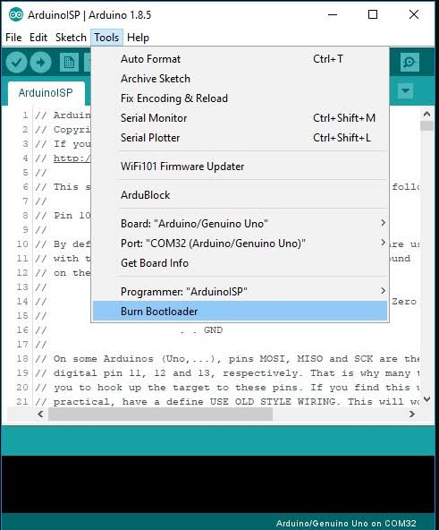
// Measure distance using ultrasonic sensor
digitalWrite(ULTRASONIC_TRIG_PIN, LOW);
delayMicroseconds(2);
digitalWrite(ULTRASONIC_TRIG_PIN, HIGH);
delayMicroseconds(10);
digitalWrite(ULTRASONIC_TRIG_PIN, LOW);
long duration = pulseIn(ULTRASONIC_ECHO_PIN, HIGH);
float distance = duration * 0.0343 / 2;
Serial.print("Distance: ");
Serial.print(distance);
Serial.println(" cm");
// Delay for stability
delay(1000);
}
void sendSMS(String message) {
// Send SMS using GSM/GPRS module
gsmSerial.println("AT+CMGF=1"); // Set SMS mode to text
delay(100);
GRTIET, Department of Electronics and Communication Engineering

Slide 23
Thanking you…!
GRTIET, Department of Electronics and Communication Engineering

